Slide 1

INTRODUCTION TO STATISTICS
MODULE 2

Slide 2

MODULE 2 OVERVIEW
INFERENTIAL STATISTICS
CONCLUSIONS BEYOND IMMEDIATE AVAILABLE DATA
BASED ON SAMPLE CONCLUDE FOR POPULATION
PROBABILISTIC APPROACH
PARAMETRIC ESTIMATION
CENTRAL LIMIT THEOREM
GOODNESS OF FIT TESTING
DESCRIPTIVE STATISTICS
PAST DATA
MAKE DECISIONS
THIS IS NO ERROR OR UNCERTAINTY ASSOCIATED IN THIS PROCESS
ADVANCED TOPICS
MONTECARLO SIMULATIONS
TIME SERIES
CURVE FITTING
STOCHASTIC CALCULUS

Slide 3
EXAMPLE OF INTUITION
Linda is 31 years old, single, outspoken and very bright. She majored in philiosophy. As a student, she was deeply concerned with issues of discrimination and social justice and also participated in anti-nuclear demonstrations. Which of the two alternatives is more probable?
(a) Linda is ONLY a banker
(b) Linda is a banker and active in the feminist movement
Data Squad | Statistics Introdution

Slide 4
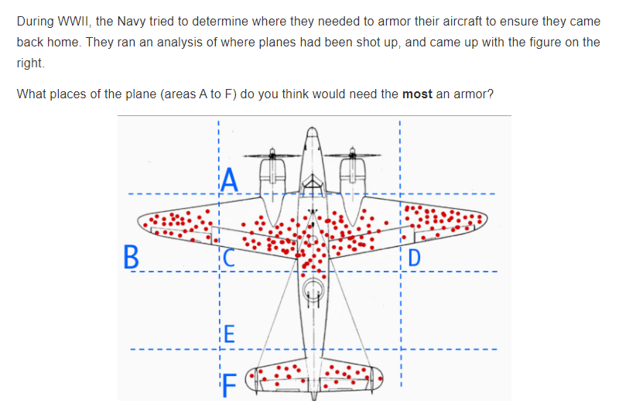
EXAMPLE OF INTUITION
This problem is related to the famous mathematician Albert Wald
Data Squad | Statistics Introdution

Slide 5
STATISTICS INTUITION - SURVIVORSHIP BIAS
BUT THE REAL REASON AGAINST ADDITIONAL ARMOR IS THAT THE HOLES PRECISELY SHOWED THE STRONGEST PARTS OF THE PLANE SINCE THE PLANE SURVIVED DESPITE THE DAMAGE IT SUFFERED.
TO PUT IT SIMPLY, THE PLANE SURVIVED DESPITE BEING HIT ON THOSE SPECIFIC PARTS, AND THAT MEANS THAT THOSE BADLY-HIT PARTS CAN WITHSTAND ENEMY FIRE.
Data Squad | Statistics Introdution

Slide 6
WHAT IS STATISTICS?
STATISTICS IS THE GRAMMAR OF NATURE’S LANGUAGE, RANDOMNESS.
Data Squad | Statistics Introdution

Slide 7
MEASURES OF DESCRIPTIVE STATISTICS
WHY DO WE NEED STATISTICAL INDICATORS OF A DATASET?
TWO TYPES: LOCATION & DISPERSION
LOCATION MEASURES CAN BE CENTRAL OR NON CENTRAL
Data Squad | Statistics Introdution

Slide 8

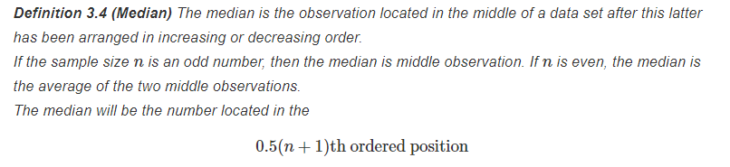


MEASURES OF CENTRAL TENDENCY AND LOCATION
ARITHMETIC MEAN
MEDIAN
MODE
Data Squad | Statistics Introdution

Slide 9
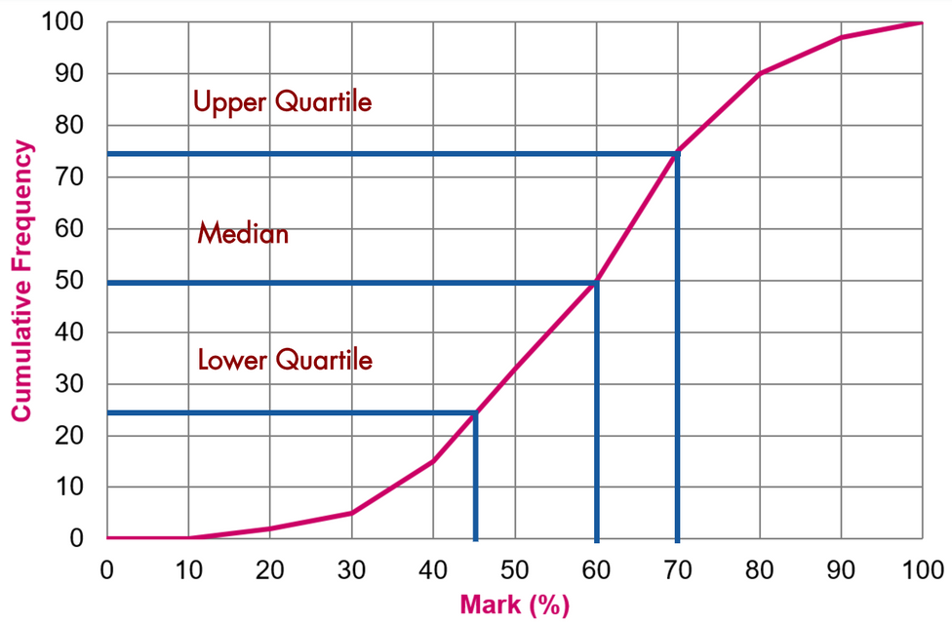
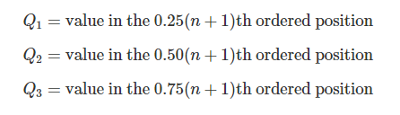

PERCENTILES AND QUARTILES
UPPER/LOWER QUARTILE
PERCENTILE
Data Squad | Statistics Introdution

Slide 10
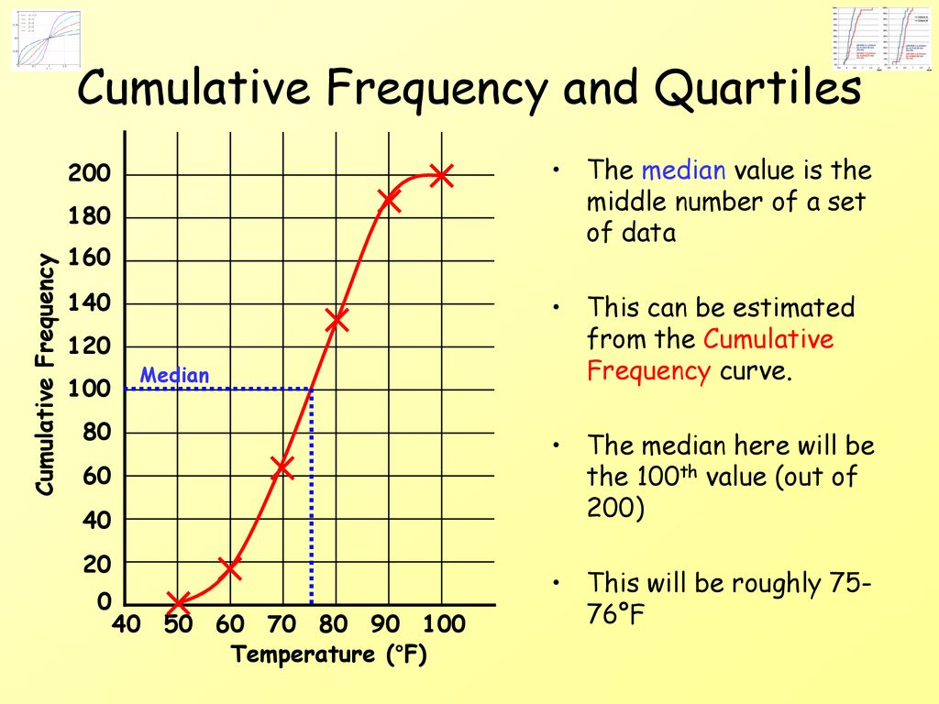
PERCENTILES AND QUARTILES
Data Squad | Statistics Introdution

Slide 11
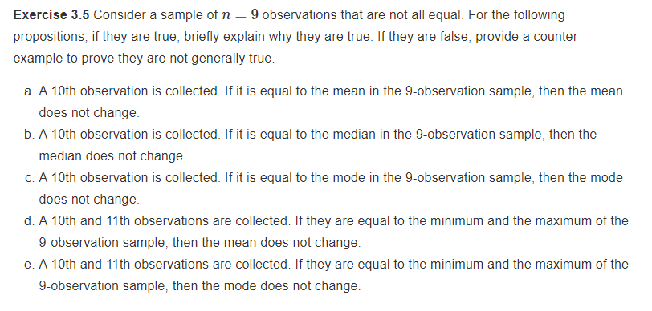
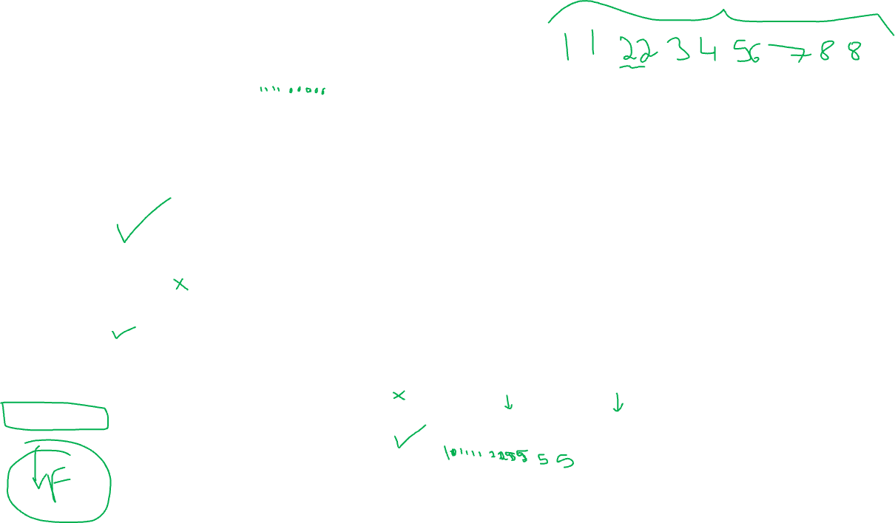
LET'S TEST
Data Squad | Statistics Introdution

Slide 12
LET'S TEST
True
Generally False
True
False
True
Data Squad | Statistics Introdution

Slide 13
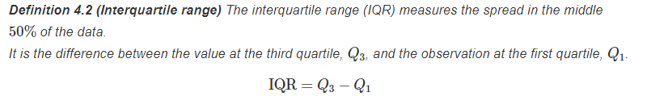
DISPERSION/VARIABILITY MEASURES
RANGE
INTERQUARTILE RANGE
Data Squad | Statistics Introdution
Data Squad | Statistics Introdution

Slide 14
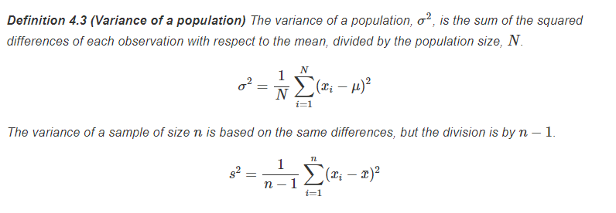
DISPERSION/VARIABILITY MEASURES
VARIANCE (SAMPLE AND POPULATION)
Data Squad | Statistics Introdution
Data Squad | Statistics Introdution

Slide 15
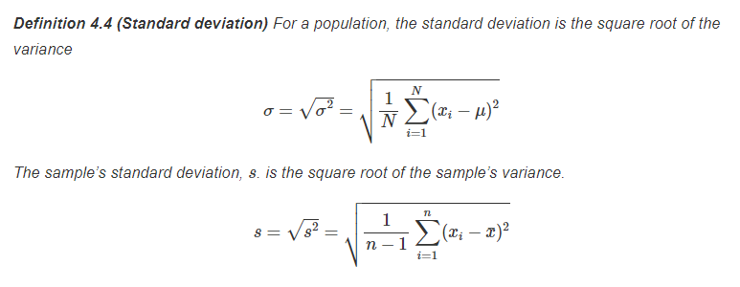
DISPERSION/VARIABILITY MEASURES
STANDARD DEVIATION (SAMPLE AND POPULATION)
Data Squad | Statistics Introdution
Data Squad | Statistics Introdution

Slide 16
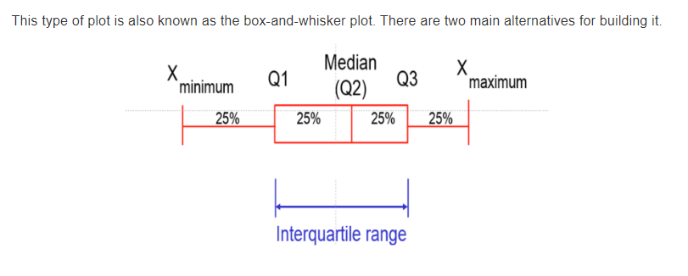
VISUAL REPRESENTATION
THE BOX-PLOT
Data Squad | Statistics Introdution
Data Squad | Statistics Introdution

Slide 17
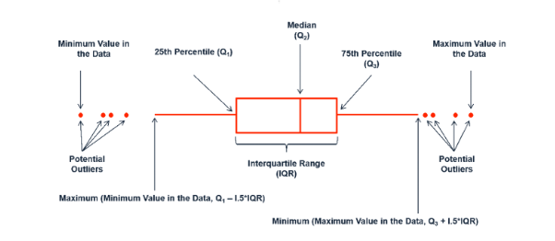

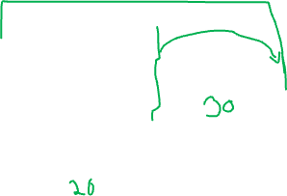
VISUAL REPRESENTATION
THE BOX-PLOT
DEFINITION OF OUTLIER
OUTLIER:
POINT > Q3 + 1.5*IQR
POINT < Q1 - 1.5*IQR
Data Squad | Statistics Introdution
Data Squad | Statistics Introdution

Slide 18

COVARIANCE
COVARIANCE IS A WAY TO DESCRIBE THE LINEAR RELATIONSHIP BETWEEN TWO VARIABLES
THE COVARIANCE DESCRIBES ONLY THE DIRECTION THE LINEAR CORRELATION BETWEEN BOTH VARIABLES AND NOT THE STRENGTH
+VE COVARIANCE -> POSITIVE RELATIONSHIP BETWEEN VARIABLES
THINK OF THE UNITS! ARE THEY RELATIVE OR ABSOLUTE?
-VE COVARIANCE -> ANTI-CORRELATION BETWEEN VARIABLES. ONE GOES UP, THE OTHER GOES DOWN
Data Squad | Statistics Introdution
Data Squad | Statistics Introdution

Slide 19

PEARSON CORRELATION
THE CORRELATION PROVIDES THE DIRECTION AND STRENGTH OF THE LINEAR RELATIONSHIP BETWEEN TWO VARIABLES
UNLIKE THE COVARIANCE, THE CORRELATION IS A RELATIVE MEASURE AND THEREFORE CAN BE USED AS COMPARISON BETWEEN DIFFERENT MEASURES/DATASETS
CORRELATION GICES US A STANDARDIZED MEASURE OF THE LINEAR RELATIONSHIP BETWEEN THE TWO VARIABLES
+1 INDICATES A PERFECT LINEAR CORRELATION
-1 INDICATES A PERCECT LINEAR ANTI-CORRELATION
Data Squad | Statistics Introdution
Data Squad | Statistics Introdution

Slide 20
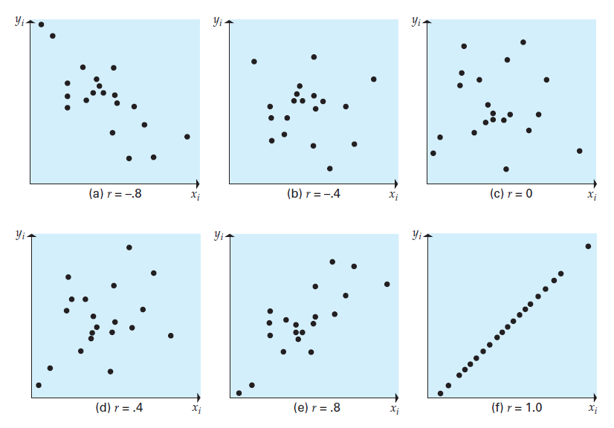
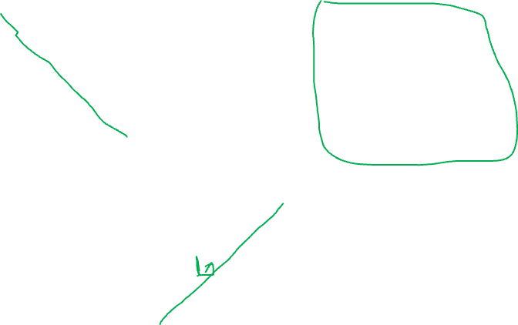
PEARSON CORRELATION
THE CORRELATION PROVIDES THE DIRECTION AND STRENGTH OF THE LINEAR RELATIONSHIP BETWEEN TWO VARIABLES
Data Squad | Statistics Introdution
Data Squad | Statistics Introdution

Slide 21
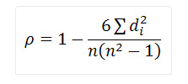
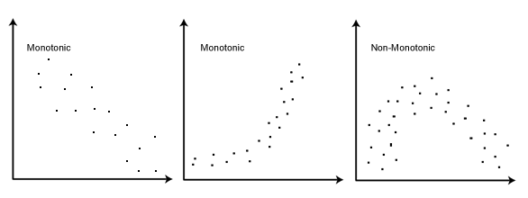

SPEARMAN CORRELATION
THE SPEARMAN CORRELATION DOESN'T LOOK FOR A LINEAR RELATIONSHIP BUT RATHER A MONOTONIC RELATIONSHIP (IN THE SAME DIRECTION). IT DOES SO BY COMPARING THE RANK OF THE POINTS
IN SPEARMAN THE RANK OF EACH POINT IS WHAT MATTERS RATHER THAN THE ABSOLUTE VALUE
Data Squad | Statistics Introdution
Data Squad | Statistics Introdution

Slide 22
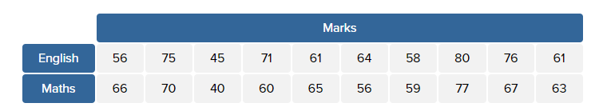
SPEARMAN CORRELATION
LET'S CALCULATE THE SPEARMAN CORRELATION BETWEEN THE GRADES OF A CLASS IN MATHS AND ENGLISH
Data Squad | Statistics Introdution
Data Squad | Statistics Introdution

Slide 23
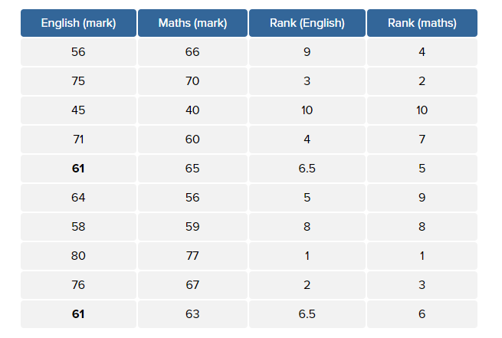
SPEARMAN CORRELATION
START BY RANKING THEM WITHIN THE RESPECTIVE COLUMN
Data Squad | Statistics Introdution
Data Squad | Statistics Introdution

Slide 24
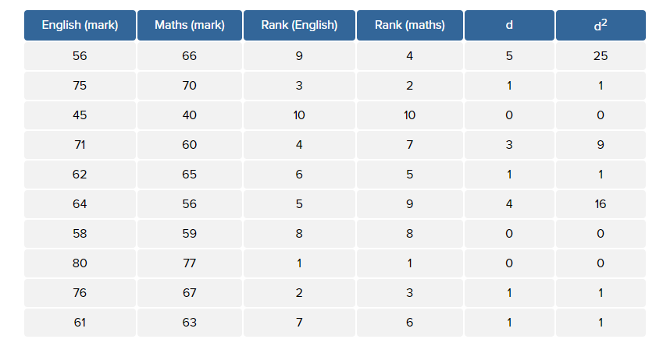

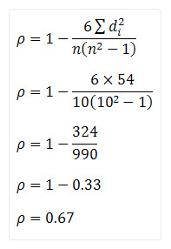
SPEARMAN CORRELATION
CALCULATE THE DIFFERENCE OF THE RANK FOR EACH STUDENT
Data Squad | Statistics Introdution
Data Squad | Statistics Introdution

Slide 25
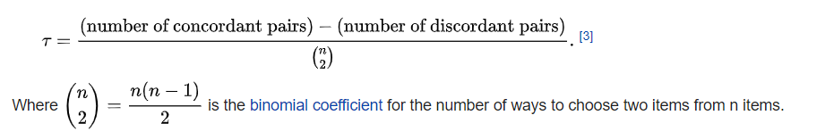
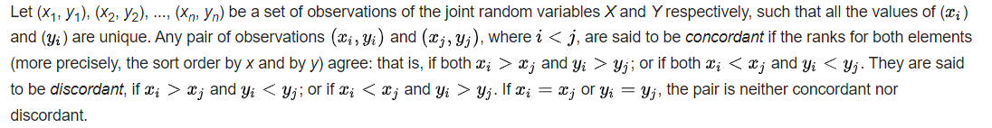
EXTRA - KENDALL TAU CORRELATION
SIMILARLY TO SPEARMAN'S CORRELATION KENDAL TAU'S DOESN'T LOOK FOR A LINEAR RELATIONSHIP BUT RATHER A MONOTONIC RELATIONSHIP (IN THE SAME DIRECTION). IT DOES SO BY COMPARING THE RANK OF THE POINTS
Data Squad | Statistics Introdution
Data Squad | Statistics Introdution

Slide 26

EXTRA - KENDALL TAU CORRELATION
SIMILARLY TO SPEARMAN'S CORRELATION KENDAL TAU'S DOESN'T LOOK FOR A LINEAR RELATIONSHIP BUT RATHER A MONOTONIC RELATIONSHIP (IN THE SAME DIRECTION). IT DOES SO BY COMPARING THE RANK OF THE POINTS
Data Squad | Statistics Introdution
Data Squad | Statistics Introdution

Slide 27
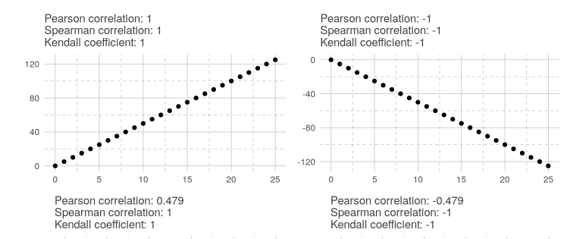
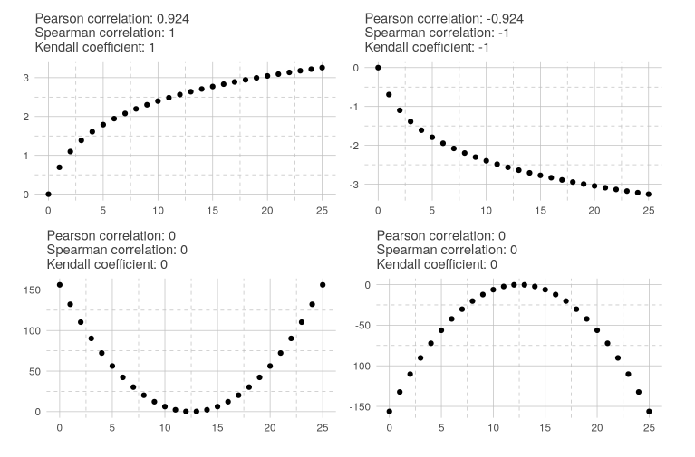
CORRELATION COMPARISONS
Data Squad | Statistics Introdution
Data Squad | Statistics Introdution

Slide 28
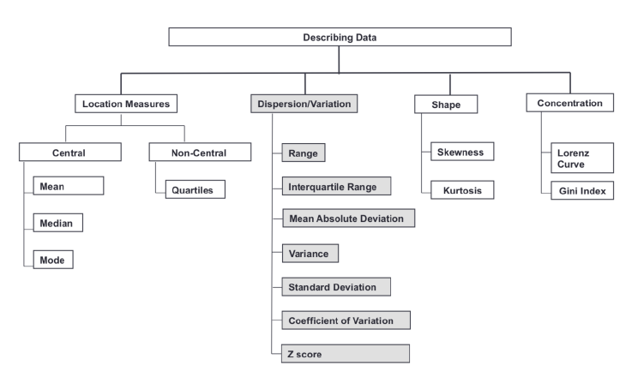
A SUMMARY
Data Squad | Statistics Introdution
Data Squad | Statistics Introdution

Slide 29
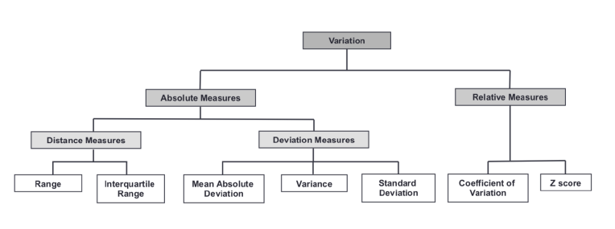
A SUMMARY - VARIABILITY
Data Squad | Statistics Introdution
Data Squad | Statistics Introdution

Slide 30
REFERENCES
CHAPTER 2, NEWBOLD, CALSON, THORNE, STATISTICS FOR BUSINESS & ECONOMICS
https://statistics.laerd.com/statistical-guides/spearmans-rank-order-correlation-statistical-guide.php
https://towardsdatascience.com/do-you-have-a-trustworthy-gut-the-most-counterintuitive-probability-problems-7b76aff941cb
Data Squad | Statistics Introdution
Data Squad | Statistics Introdution

Slide 31
ANY QUESTIONS ?

Slide 32
APPENDIX
Data Squad | Statistics Introdution
Data Squad | Statistics Introdution

Slide 33
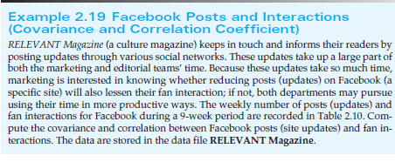
COVARIANCE
EXAMPLE FROM TEXTBOOK
Data Squad | Statistics Introdution
Data Squad | Statistics Introdution

Slide 34
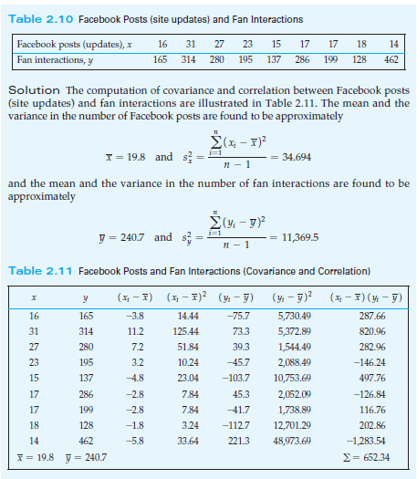

COVARIANCE
APPLYING THE EQUATION ABOVE (FOR SAMPLE)
Data Squad | Statistics Introdution
Data Squad | Statistics Introdution

Slide 35
COVARIANCE
EXAMPLE FROM TEXTBOOK
Data Squad | Statistics Introdution
Data Squad | Statistics Introdution

Slide 36

WRAPPING IT UP
DATA DOES NOT SUPPORT STRON LINEAR RELATIONSHIP BETWEEN POSTS AND FAN INTERACTION
Data Squad | Statistics Introdution
Data Squad | Statistics Introdution

